Slide 1
Course
AWS Cloud Practitioner
MaxCloud

Slide 2
03
Class
Amazon EC2 Auto Scaling
Amazon EC2
Amazon EBS

Slide 3
AWS Lambda
AWS Lambda is a compute service that lets you run code without provisioning or managing servers.
Lambda runs your code on a high-availability compute infrastructure and performs all of the administration of the compute resources, including server and operating system maintenance, capacity provisioning and automatic scaling, and logging.

Slide 4
When to use lambda
File processing: Use Amazon Simple Storage Service (Amazon S3) to trigger Lambda data processing in real time after an upload.
Stream processing: Use Lambda and Amazon Kinesis to process real-time streaming data for application activity tracking, transaction order processing, clickstream analysis, data cleansing, log filtering, indexing, social media analysis, Internet of Things (IoT) device data telemetry, and metering.
Web applications: Combine Lambda with other AWS services to build powerful web applications that automatically scale up and down and run in a highly available configuration across multiple data centers.
IoT backends: Build serverless backends using Lambda to handle web, mobile, IoT, and third-party API requests.
Mobile backends: Build backends using Lambda and Amazon API Gateway to authenticate and process API requests. Use AWS Amplify to easily integrate with your iOS, Android, Web, and React Native frontends.

Slide 5
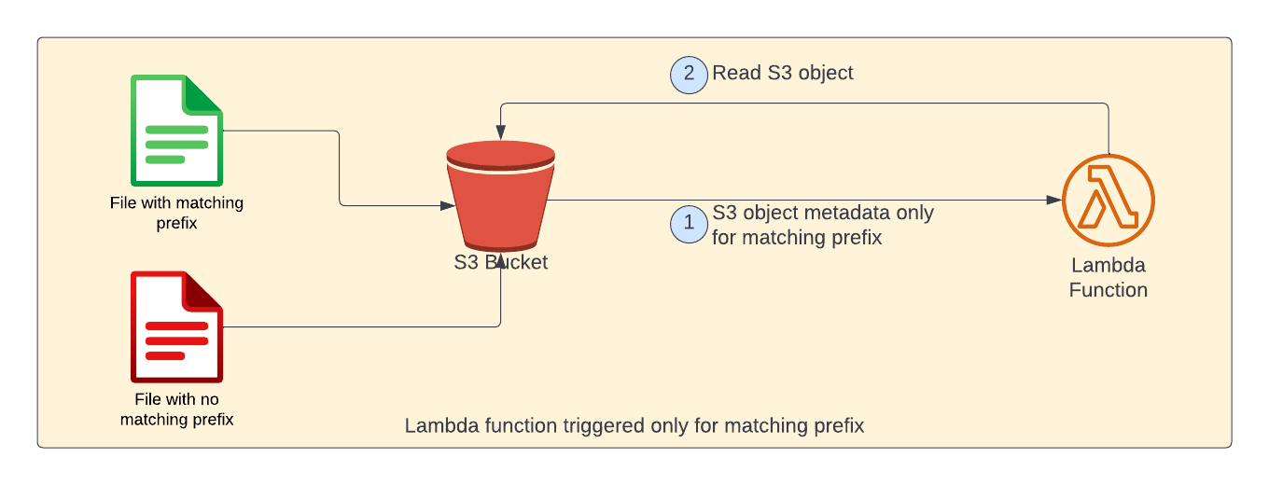
Lambda with S3

Slide 6
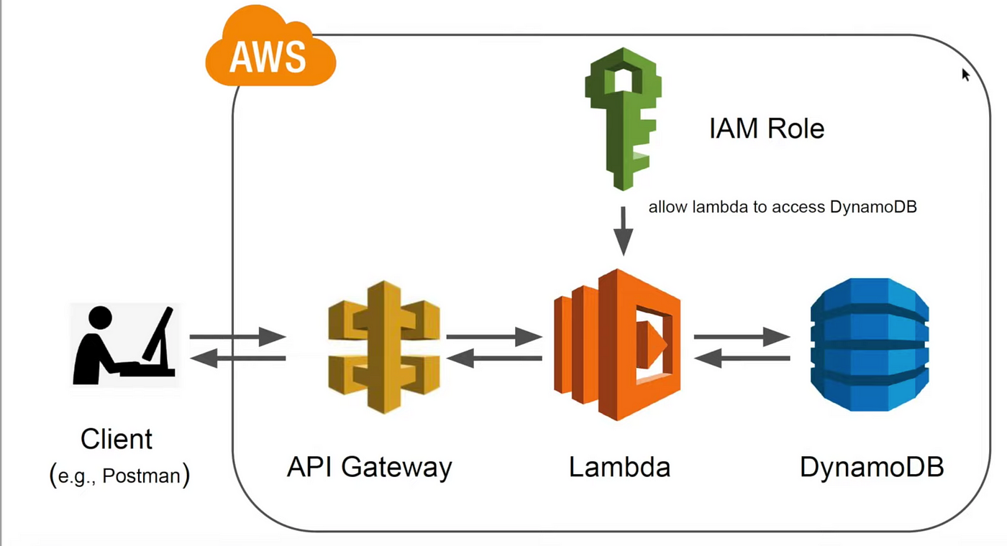
Lambda with API Gateway

Slide 7
Muchas Gracias

